Slide 1
Super Bowl Ads
Hierarchical clustering and K-means Clustering Project by:
Nick Schulz
Julie Whitsitt
Anthony Chavez

Slide 2
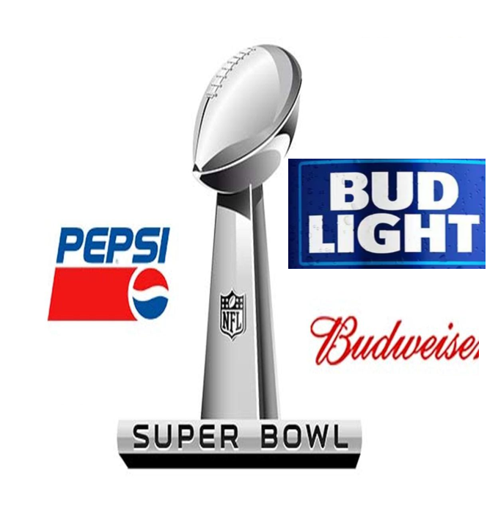
Dataset: Super Bowl Commercials
Our data consists of:
3 brands:
Bud Light
Budweiser
Pepsi
21 Super Bowls (2000-2021)
YouTube like count
YouTube view count
How quickly the commercial shows the product
Whether the commercials contain:
Humor
Contain patriotic elements
Celebrities
Danger
Animals
Sexuality

Slide 3
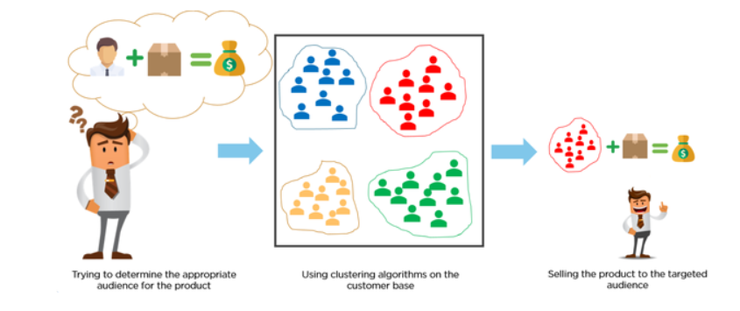
Business Objectives and Problem Statement
Our beverage company is considering a Super Bowl commercial. We will use clustering to determine which type of commercials are the most popular and get the most views. The information gathered will inform the content we include in our commercial.
Brand Equity
Viewership

Slide 4
Model Selection, Analysis and Results
Model Selection:
Market Segmentation Clustering Methods
Hierarchical Agglomerate Clustering
Kmeans Clustering
Observations:
Bud Light has the most ads
Bud Light uses the humor and animal consistently
Budweiser has fewer commercials and averages the most views
Pepsi has the lowest number of ads
Bud Light # of ads: 63, Avg. Views: 221,170 | Budweiser # of ads: 43, Avg views: 883,502 | Pepsi # of ads: 25, Avg views: 118,028

Slide 5
Model Selection, Analysis and Results
Analysis:
Bud Light has the most ads with an average viewers of 229185.
Bud light uses the funniest and animal ads
Budweiser has less commercials but higher viewers(avg 2.4M)

Slide 6
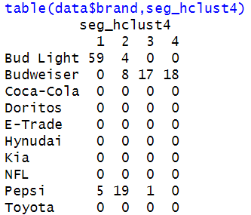
Hierarchical Clustering
4 Cluster solution
Optimal #of clusters is 4

Slide 7
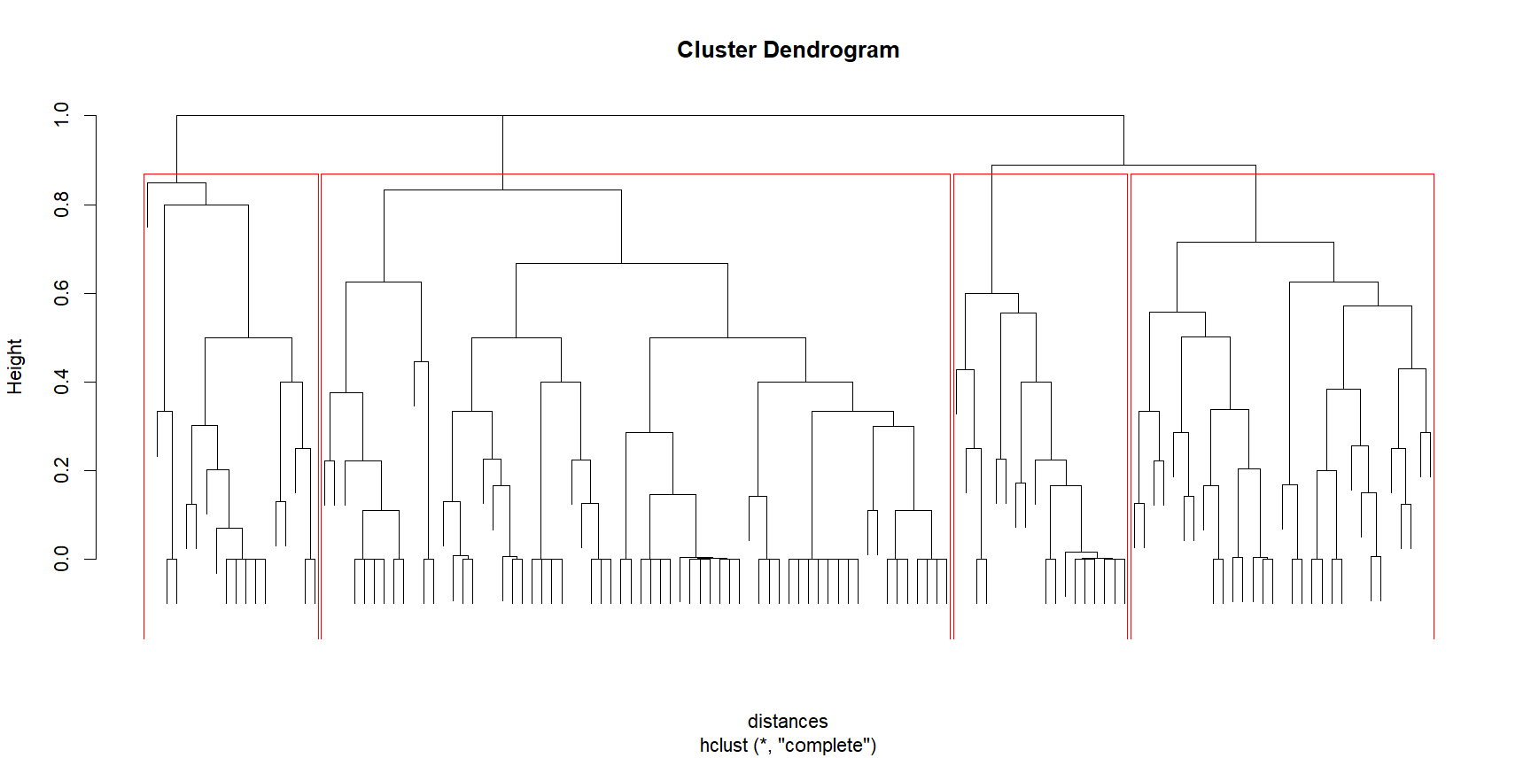

Slide 8
Model Selection, Analysis and Results
Observations:
-Low ROI

Slide 9
Managerial Interpretation
Target Audience Segmentation:
Cluster analysis identifies distinct audience segments for each brand.
Tailor our content to match preferences for maximum engagement.
Allocate resources based on segment size and engagement potential.
Content Strategy:
Prioritize humor, seeing the product, and animals.
Emphasize brand/product and targeting specific emotion (humor, excitement, national-pride etc.).
Refine strategies based on audience feedback.
Enhancing Brand Equity:
Align content with our brand’s identity and values.
Monitor sentiment pre- and post-launch.
Strengthen brand perception and connection to our target audience.
Measuring Success:
Track view counts, engagement, and audience sentiment.
Compare performance to industry benchmarks.
Inform future advertising strategies based on changing trends over time.
Resource Allocation:
Allocate resources based on audience segmentation and catering to our brands audience.
Invest in high-impact content elements.
Balance creativity and cost-effectiveness to make most of short, expensive ad space.

Slide 10
Future Work
Refine Audience Segments:
Breakdown audience by different demographics
Explore other types of ad content and it’s engagement
Continuous Content Optimization:
Fine-tune elements and content combinations for most engagement
Experiment with new, emerging ad-trends
Expansion of Brand Presence:
Explore opportunities beyond traditional on-air commercials
Expand into new markets or demographics
Long-Term Brand Building:
Establish an ad tone/style that audience will always associate with our brand
Develop brand loyalty and awareness through continued engagement strategy

